Slide 1
Simple serverless CI/CD with in Amazon clouds
Serhii Shuliar

Slide 2
About
I’m software engineer that works with DevOps practices and tools for last 5 years at SoftServe company. Experienced in Amazon AWS and certified AWS SysOps Administrator
All my life I was working as developer and/or Linux/Windows system administrator and was involved in all SDLC proceses. In 2012 I started use DevOps practice in my work. From that time to now main cloud service for me is AWS. I was involved in AWS certification of our company.
I really like Amazon Web Service cloud and trying to use all AWS services in my work and personally to do my work quicker save costs and build reliable, flexible, fast and cost effective infrastructure

Slide 3
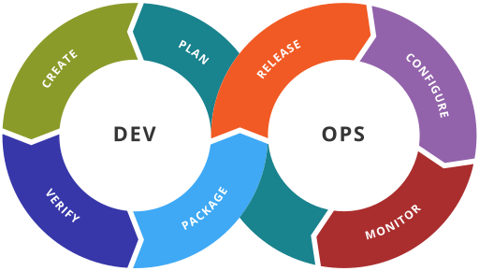
DevOps span the entire delivery pipeline.
Improved deployment frequency
Faster time to market
Lower failure rate of new releases
Shortened lead time between fixes
Faster mean time to recovery

Slide 4
Serverless tools in AWS
Amazon S3
Amazon S3 is object storage with a simple web service interface to store and retrieve any amount of data from anywhere on the web. It is designed to deliver 99.999999999% durability and scale past trillions of objects worldwide.
For static website, you simply upload files to an S3 bucket and configure your S3 bucket for web hosting.
Amazon API Gateway
Amazon API Gateway is a fully managed service that makes it easy for developers to create, publish, maintain, monitor, and secure APIs at any scale. With a few clicks in the AWS Management Console, you can create an API that acts as a “front door” for your back-end services, such as workloads running on EC2, or on AWS Lambda, or any web application.
AWS Lambda
AWS Lambda lets you run code without provisioning or managing servers. You pay only for the compute time you consume - there is no charge when your code is not running.

Slide 5
DevOps tools in AWS
AWS CodePipeline
AWS CodePipeline is a continuous integration and continuous delivery service for fast and reliable application and infrastructure updates. CodePipeline builds, tests, and deploys your code every time there is a code change, based on the release process models you define. This enables you to rapidly and reliably deliver features and updates.
AWS CodeBuild
AWS CodeBuild is a fully managed build service that compiles source code, runs tests, and produces software packages that are ready to deploy. With CodeBuild, you don’t need to provision, manage, and scale your own build servers. CodeBuild scales continuously and processes multiple builds concurrently, so your builds are not left waiting in a queue.
AWS CodeDeplo
AWS CodeDeploy automates code deployments to any instance, including Amazon EC2 instances and on-premises servers. AWS CodeDeploy makes it easier for you to rapidly release new features, helps you avoid downtime during application deployment, and handles the complexity of updating your applications.

Slide 6
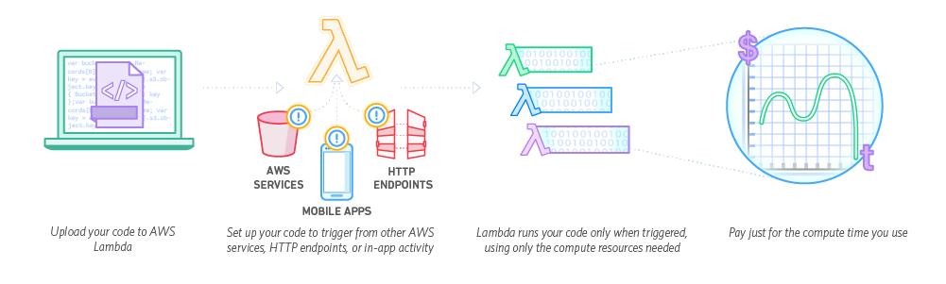
AWS Lambda integration AWS

Slide 7
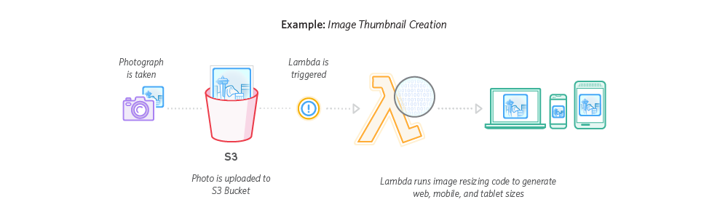
AWS Lambda integration with S3

Slide 8
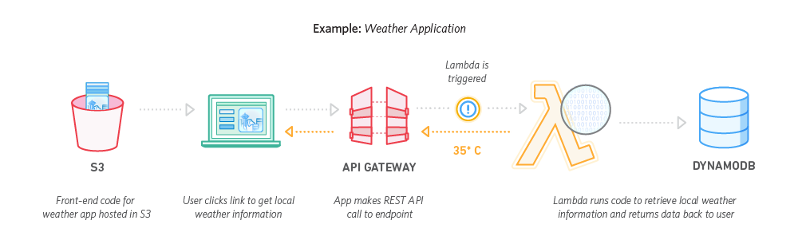
AWS Lambda integration with API Gateway

Slide 9
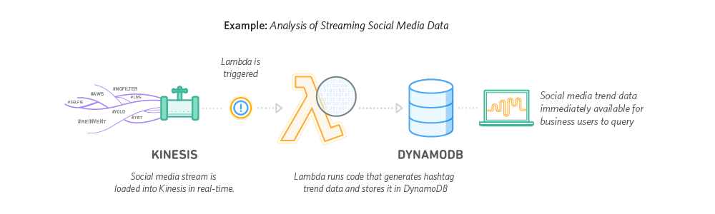
AWS Lambda integration with Data streems

Slide 10
AWS Lambda integration with Data streems

Slide 11
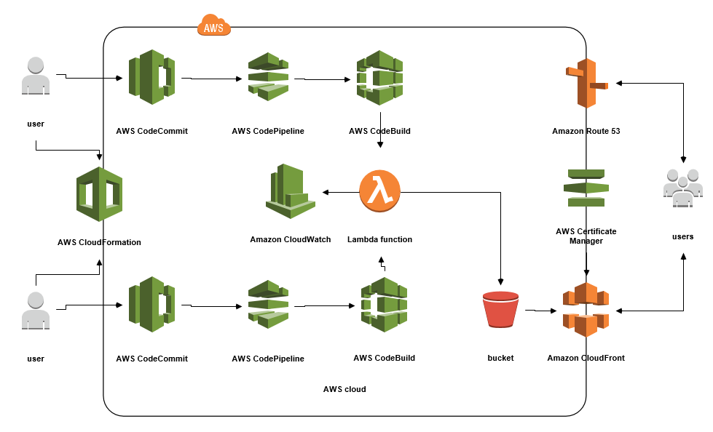
Simple CI pipeline with AWS lambda

Slide 12
What does it cost?
Service | Item | Cost | Subtotal
S3 | 5 GB storage | $0.12 | $0.12
 | 5000 put/list requests | $0.03 | $0.15
 | 100,000 Get and Other Requests | $0.04 | $0.19
 | Inter region bucket transfers of 1GB/month (depends on CodePipeline/Commit region availability) | $0.02 | $0.21
Route53 | Hosted zone | $0.50 | $0.71
 | Standard queries: 1 million / month | $0.40 | $1.11
CodePipeLine | 1 Free pipeline per month | $0.00 | $1.11
CodeCommit | First 5 users free with 50GB storage and 10,000 git requests/month | $0.00 | $1.11
Lambda | Memory: 256Mb you get 1,600,000 seconds of compute time for free | $0.00 | $1.11
Free tier | Discount | -$0.14 | $0.97
 |  |  | $0.97

Slide 13
Compare to Wordpress (no custom domain and SSL certificate costs included)
Service | Monetize | Cost
Static site on AWS | Yes | $1.11
Wordpress Free (No custom domain) | No | $0.00
Wordpress Personal | No | $4.00
Wordpress Premium | Yes | $8.00

Slide 14
Questions and answers

